Slide 1
Design of Secure Remote Diag on Container Separation Architecture
Candidate: Vu Hoang Phi (phi.vu)
LGEDV – September 2026

Slide 2
Content
1
Context & Motivation
2
Problem
3
Quality Attribute
4
Design Alternative
5
Comparison & Decision
6
Implementation & Verification

Slide 3
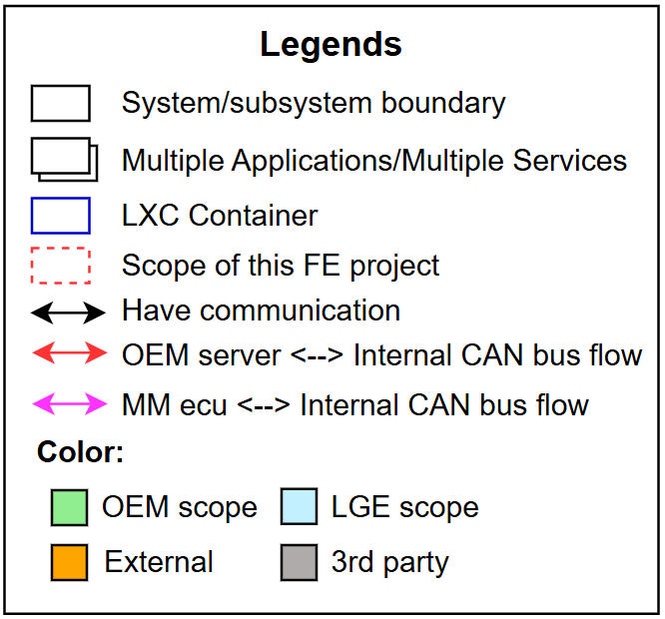
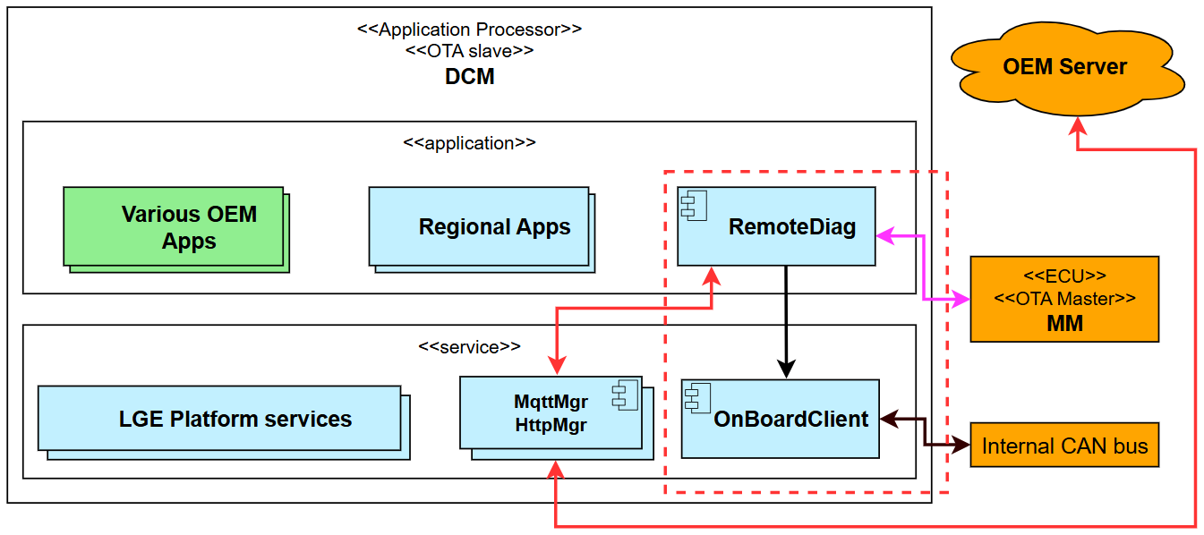
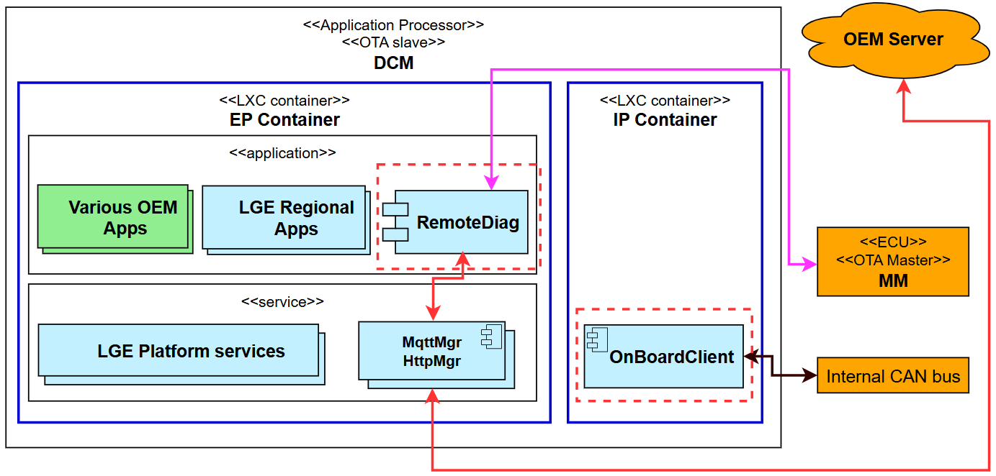
Context & Motivation – Toyota 24DCM project
Toyota DCM: a telematics platform providing connected vehicle services, including remote diagnostics from OEM server.
Supports diagnostic communication and OTA updates through the Internal CAN bus.
Current architecture: monolithic deployment model, with all components running in a single partition.
System architecture migration:
  Due to security, OEM wants to separate DCM into 2 partition using LXC containers:
    EP container (Entry Point): externally exposed network components
    Internal container: components which have access to CAN bus.
Current system architecture
New system architecture (containerized)

Slide 4
Context & Motivation – Toyota 24DCM project
Toyota DCM: a telematics platform providing connected vehicle services, including remote diagnostics from OEM server.
Supports diagnostic communication and OTA updates through the Internal CAN bus.
Current architecture: monolithic deployment model, with all components running in a single partition.
System architecture migration:
  Due to security, OEM wants to separate DCM into 2 partition using LXC containers:
    EP container (Entry Point): externally exposed network components
    Internal container: components which have access to CAN bus.
Current system architecture
New system architecture (containerized)

Slide 5
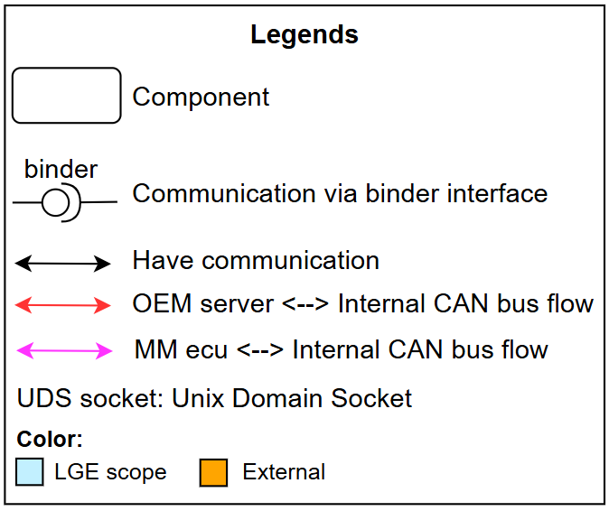
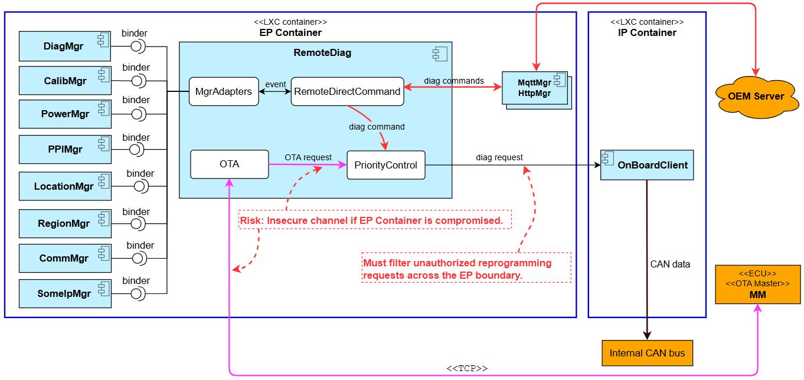
Problem
RemoteDiag: a module processes diagnostic for each ECU and uploads diagnostic data to OEM Server
RemoteDiag has 2 communication paths:
  with OEM Server: performs direct diagnostic commands
  with MM ecu: OTA diagnostic update
Risk: RemoteDiag <-> MM path routes in EP which is insecure
OEM requests that unauthorized reprogramming requests should be filtered.
RemoteDiag’s internal architecture and communication should be redesigned to align with new architecture

Slide 6
Problem
Functional requirements
# | Description
FR-01 | The system shall block unauthorized diagnostic commands related to ECU reprogramming.
FR-02 | The system shall route UDS diagnostic messages exchanged with the MM ECU entirely within the IP.

Slide 7
Quality Attribute
ID | QA Scenario | Measure | Type | Priority
QA-01 | A compromised app/service sends reprogramming diagnostic to CAN | Zero Reprogramming SIDs reaches the internal CAN. | Security | High
QA-02 | MM ECU sends a diagnostic request via TCP to RemoteDiag | Zero diagnostic communication is found in EP. 100% number of requests are handled within IP. | Security | High
QA-03 | The new design preserves the original core responsibility of each component. | No component is required to take responsibilities outside its originally defined role. No additional specification updates caused by responsibility expansion. | Modifiability | High
QA-04 | Existing software components (other than RemoteDiag) require minimal changes. | Number of component which needs to modify to align with new design | Maintainability | Medium
QA-05 | Failure in OEM Center flow or MM ECU flow | The other flow remains operational | Availability | Low

Slide 8
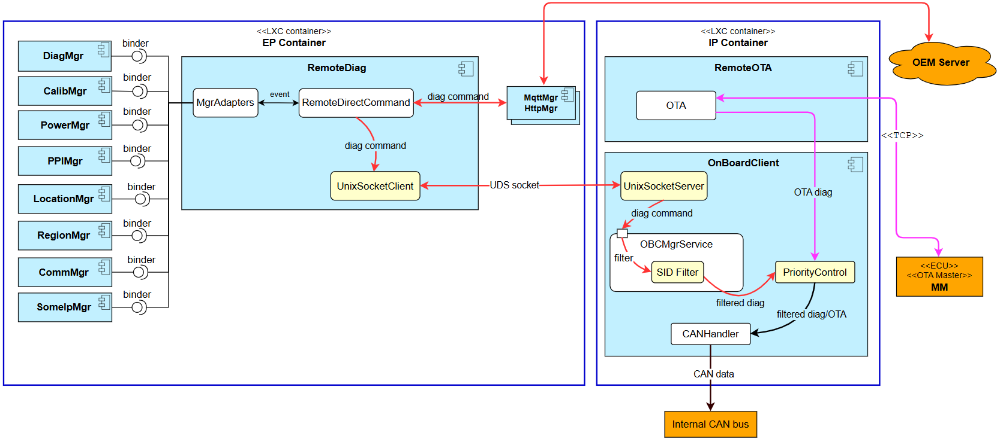
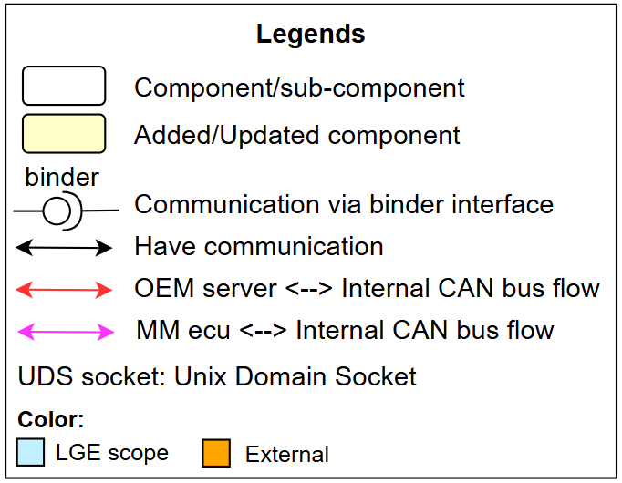
Design Alternative – Alt-A: Split RemoteDiag
Split RemoteDiag responsibilities into 2 apps:
  RemoteDiag (EP): handles diag messages from OEM server.
  RemoteOTA (IP): handles OTA diag message flows from MM ECU.
OnBoardClient is responsible for reprogramming message filtering and diagnostic priority control.
Alt-A

Slide 9
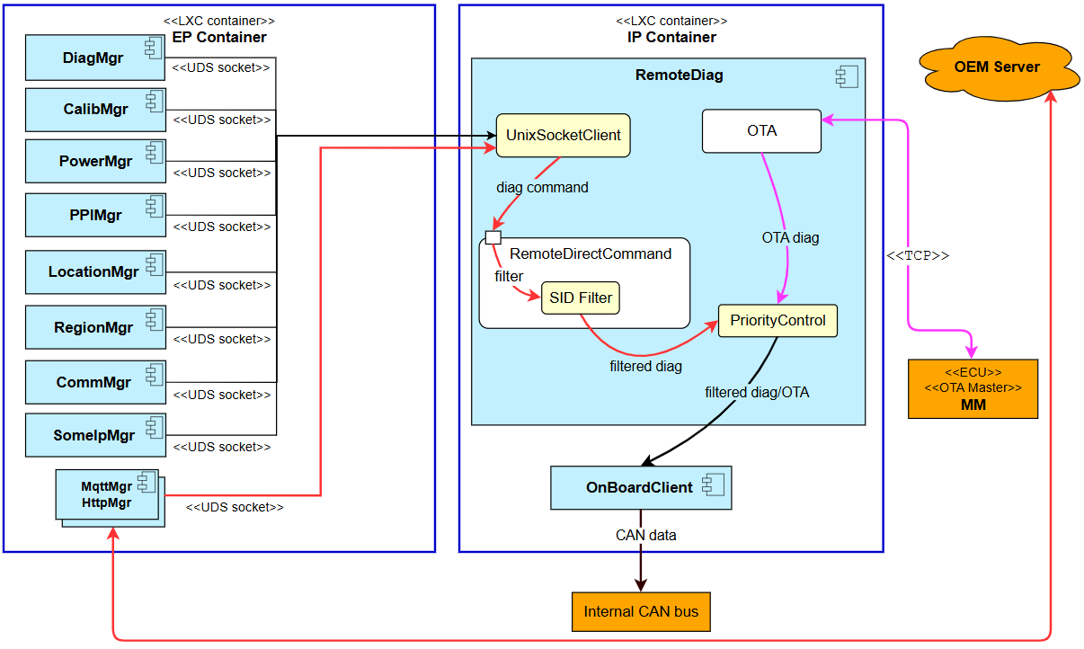
Design Alternative – Alt-B: Move RemoteDiag
Move RemoteDiag into the IP container.
To maintain communication with OEM server and other EP-side component, establish UDS socket connections to each module
Alt-B
Notes:
Trade-offs
Maintainability: All EP modules require cross-container IPC support, increasing implementation effort and code-change scope.

Slide 10
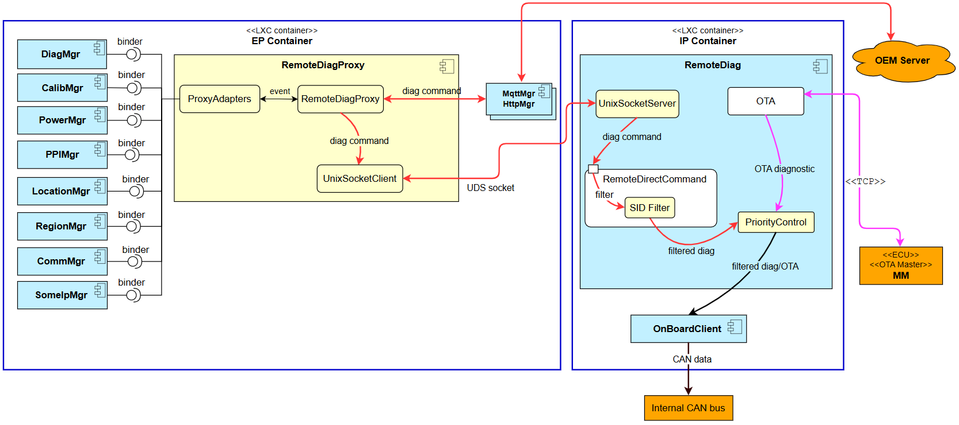
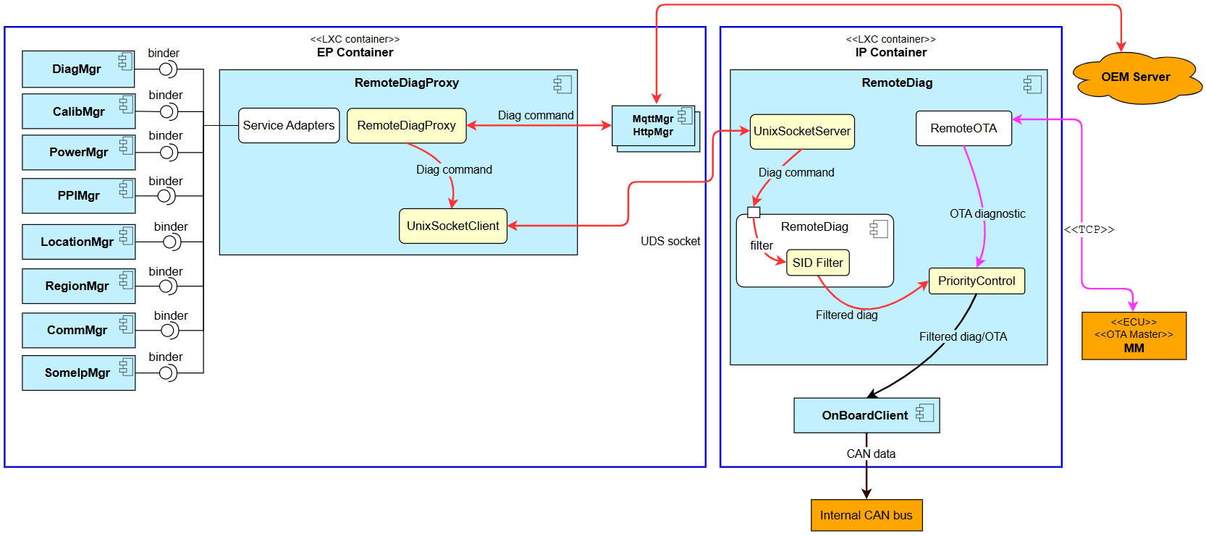
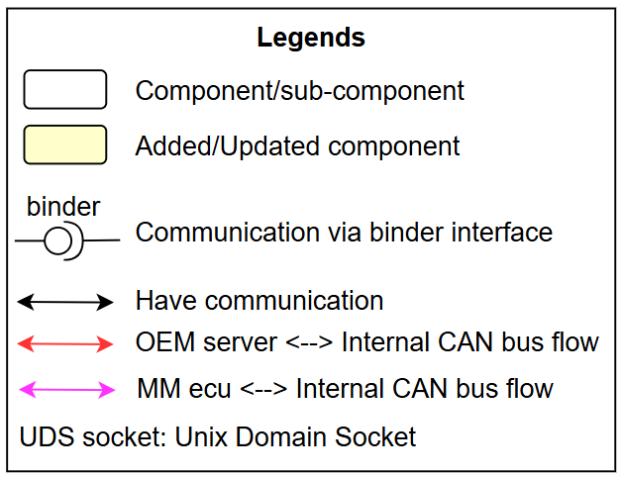
Design Alternative – Alt-C: Move RemoteDiag + Proxy
Move RemoteDiag into the IP container.
Add a new RemoteDiagProxy (RDP) component in the EP that acts as a transparent proxy.
EP modules continue to interact with RDP using their existing interface
RDP forwards requests to RemoteDiag via UDS socket channel.
Alt-C

Slide 11

Comparison & Decision
 | Alt-A – Split RemoteDiag | Alt-B: Move RemoteDiag | Alt-C: Move RemoteDiag + Proxy
QA-01 Security | High Unauthorized diagnostic commands are filtered. | High Unauthorized diagnostic commands are filtered. | High Unauthorized diagnostic commands are filtered.
QA-02 Security | High MM ECU diagnostic traffic remains within the EP container. (CyberSecurity team confirmed) | High MM ECU diagnostic traffic remains within the EP container. (CyberSecurity team confirmed) | High MM ECU diagnostic traffic remains within the EP container. (CyberSecurity team confirmed)
QA-03 Modifiability | Low RemoteDiag and OnBoardClient’s responsibility is changed (diagnostic priority control is moved to OnBoardClient), requiring requirement updates. | High Core responsibilities of existing components remain unchanged after migration. | High Core responsibilities of existing components remain unchanged after migration.
QA-04 Maintainability | Medium 01 additional component is modified (OnBoardClient - implements UDS socket server and priority control) | Low 10 EP modules (PowerMgr, HttpMgr, …) have to implement cross-container UDS socket communication and fail-safe handling. | High No changes required in existing modules. RemoteDiagProxy preserves the current binder interface
QA-05 Availability | High OEM center and MM ECU communication flows run in separate processes. Failure of one flow does not impact the other. | Low OEM center and MM ECU communication flows share the same process. Failure in one flow may impact the other. | Low OEM center and MM ECU communication flows share the same process. Failure in one flow may impact the other.
Decision | Rejected | Rejected | Selected
Final decision: Alt-C
High: Fully satisfy
Medium: Partially satisfy
Low: Not satisfy

Slide 12
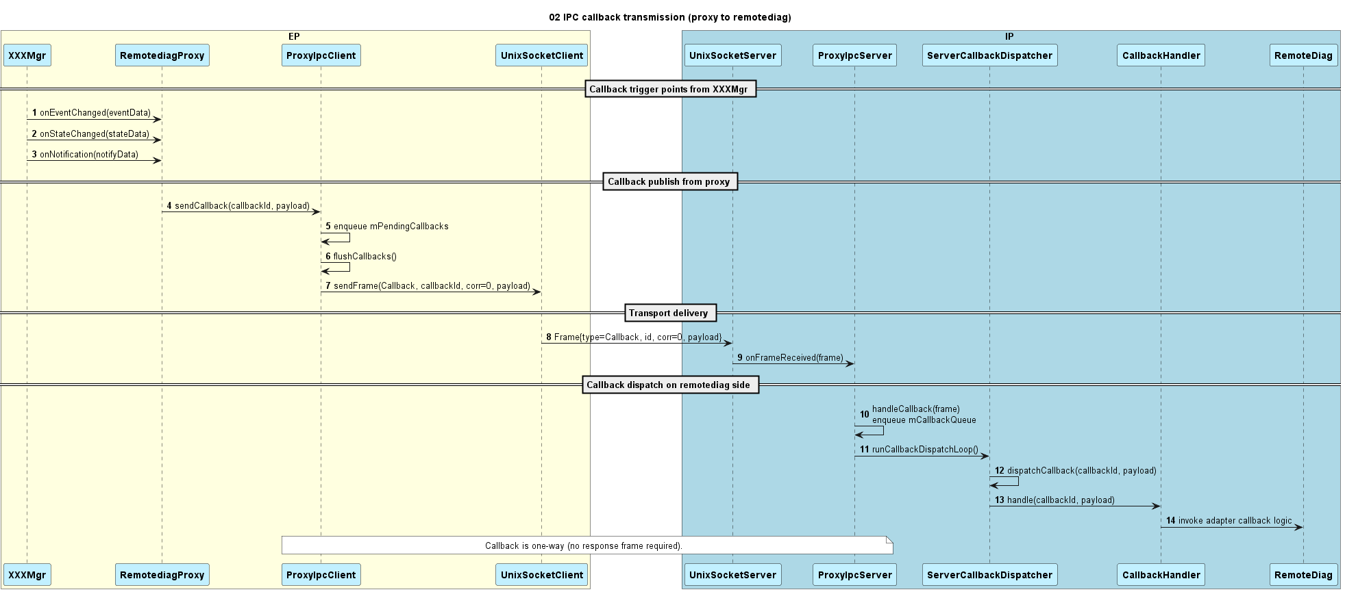
Detail design: Forward API call from proxy to remotediag

Slide 13
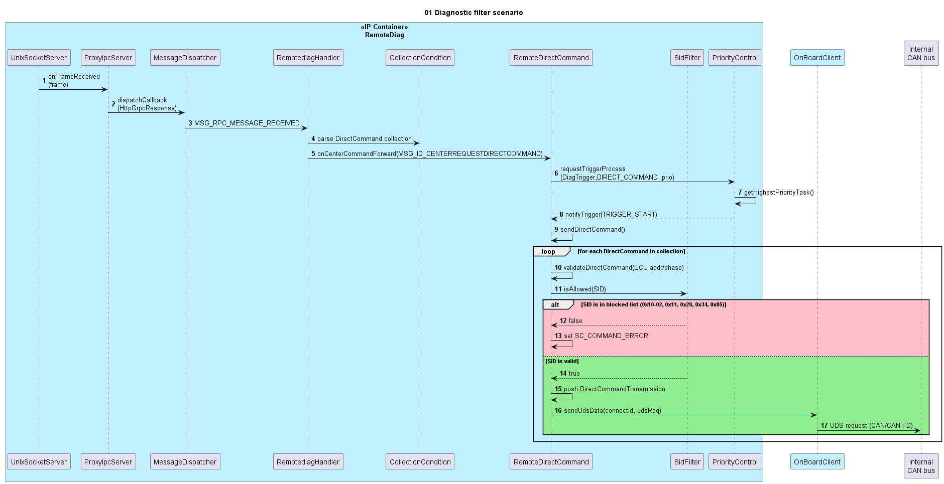
Detail design: Filter scenario

Slide 14
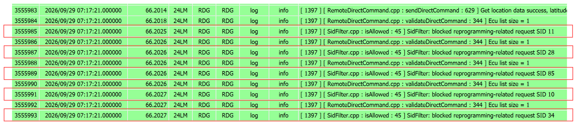
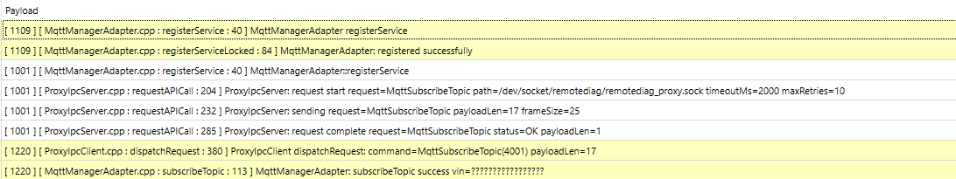
Implementation and Verification
SidFilter blocks reprogramming diagnostic requests

Slide 15
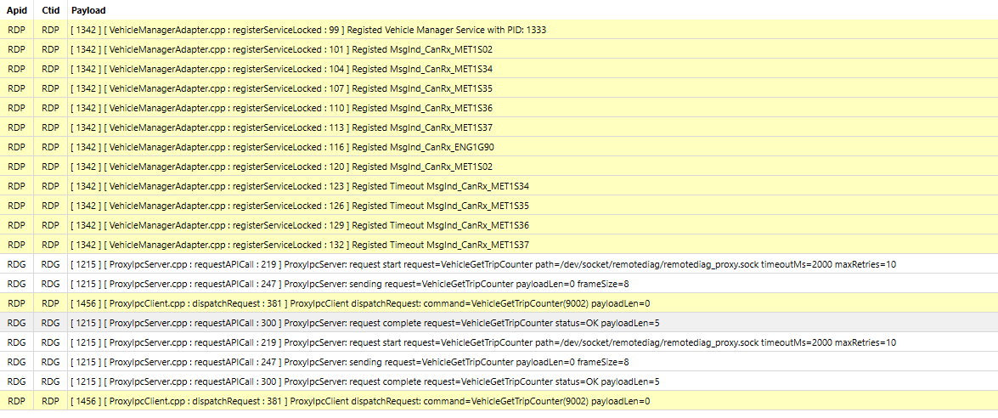
Implementation and Verification
RemoteDiagProxy and RemoteDiag communication

Slide 16
Q&A
Thank you for listening

Slide 17
Appendix

Slide 18
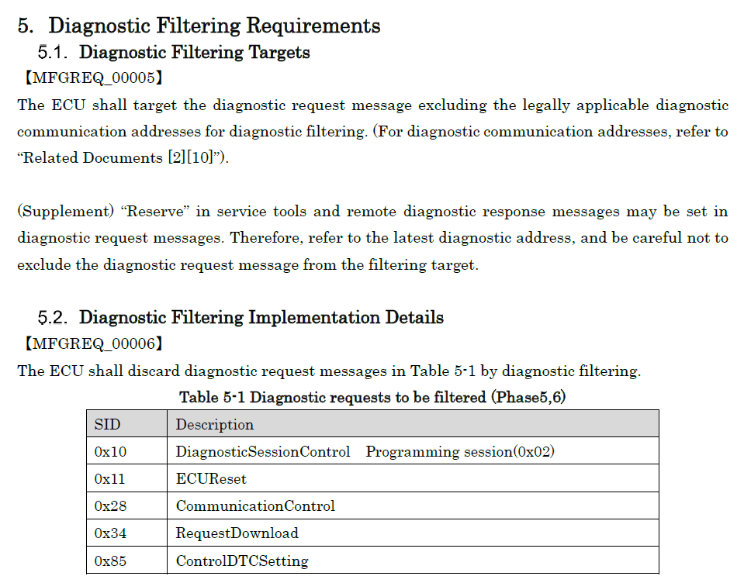
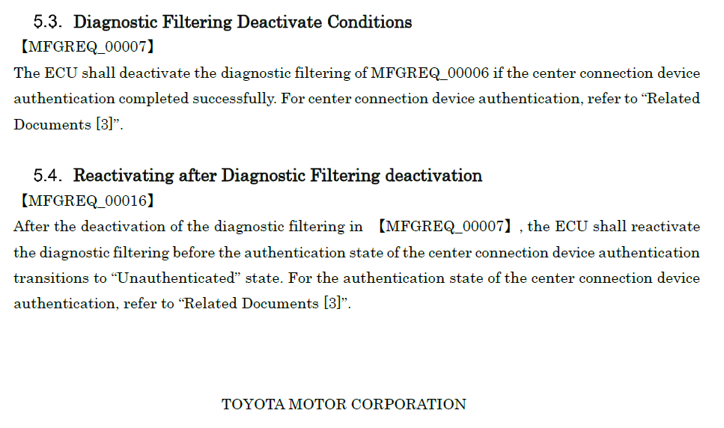
Diagnostic filtering requirements

